Slide 1
VISUAL PREDICATOR: LEARNING ABSTRACT WORLD MODELS WITH NEURO-SYMBOLIC PREDICATES FOR ROBOT PLANNING
Yichao Liang, Nishanth Kumar, Hao Tang, Adrian Weller, Joshua B. Tenenbaum,Tom Silver, Jo˜ao F. Henriques, Kevin Ellis
By：周桢瑜

Slide 2



Yichao Liang(梁毅超）
a PhD student at the Computational and Biological Learning Lab (CBL),collaborating with Computational Cognitive Science group (CoCoSci) at MIT and the Visual Geometry Group (VGG) at Oxford.
Hao Tang
a Ph.D. student at Cornell University.
Adrian Weller
a Director of Research in machine learning (ML) at the University of Cambridge.Adrian is head of Safe and Ethical AI at The Alan Turing Institute (UK national institute for data science and AI).

Slide 3
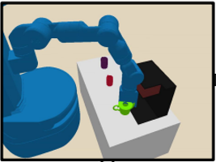
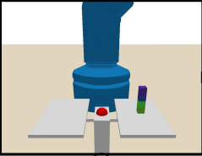
Background
We consider a robot that encounters a new environment involving novel physical mechanisms and new kinds of objects, and which must learn how to plan in this new environment from relatively few environment interactions (the equivalent of minutes or hours of training experience).Traditional robot task planning uses hard-coded symbolic world models that cannot adapt to novel environments.

Slide 4
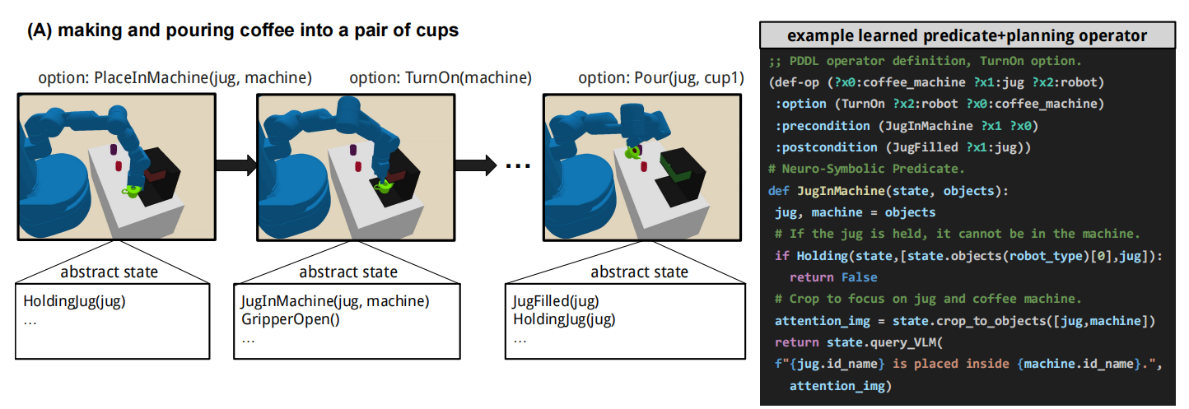
Neuro-Symbolic Predicates(NSP)
Neuro-Symbolic Predicates (NSPs) represent visually grounded yet logically rich abstractions that enable efficient planning and problem solving.

Slide 5
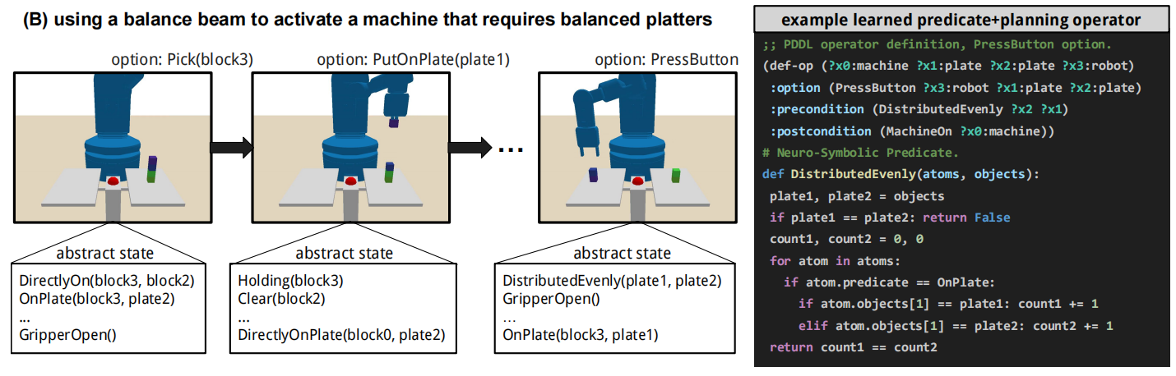
Neuro-Symbolic Predicates(NSP)
These predicates are neuro symbolic because they combine programming language constructs (conditionals, numerics, loops and recursion) with API calls to neural vision-language models for evaluating visually-grounded natural language assertions.

Slide 6

High-Level Actions（HLA）: Refining the action space
State
added EFF⁺
removed EFF⁻
Statewith PRE
π
π is a skill(action)
The precondition is PRE
The postcondition consists of
EFF+ (predicates added to the abstract state)
and
EFF− (predicates removed from the abstract state).

Slide 7




High-Level Actions（HLA）: Refining the action space
Example:
State
added EFF⁺
removed EFF⁻
Statewith PRE
π
Block
under
Block
under
Block
Block
Table
Table

Slide 8
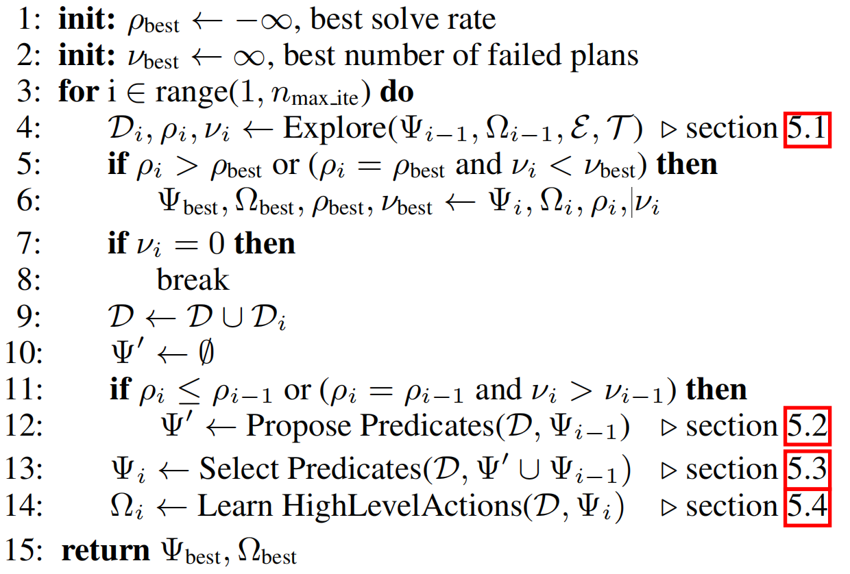





Algorithm
实验提供的环境
任务目标
NSP谓词集（初始仅含有目标谓词）
HLA集（初始为空）
数据集（初始为空，除非从别的环境迁移）
（由VLM生成）

Slide 9
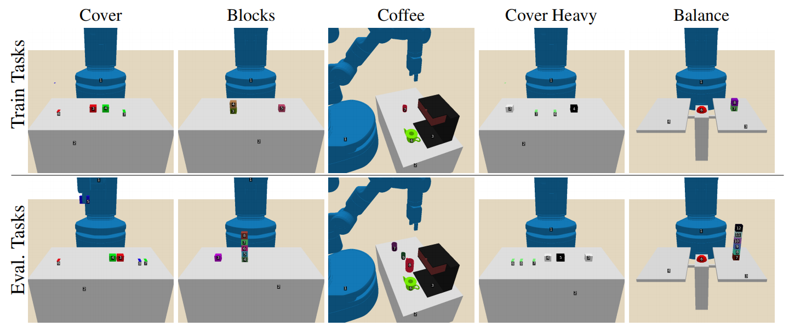
Experiment

Slide 10
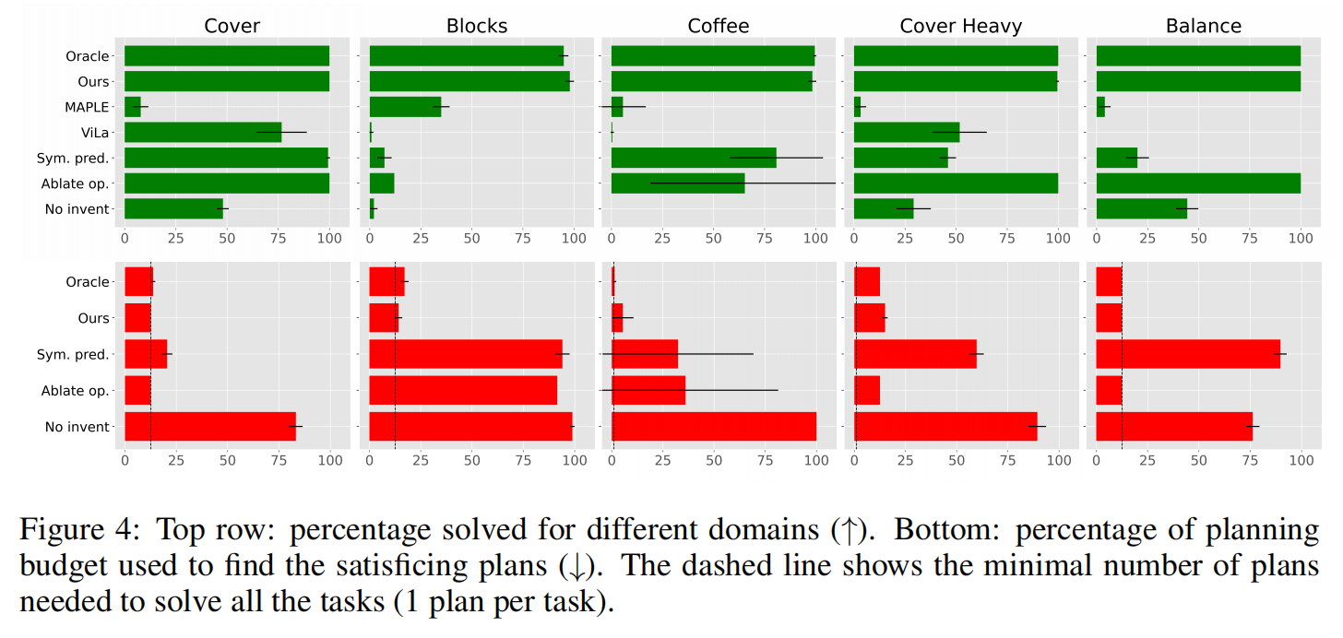
Experiment

Slide 11
Conclusion
NSP方法在学习抽象世界模型上表现出色，能够显著提高智能体在复杂任务中的规划和执行能力。
NSP方法在所有测试领域均优于HRL（分层强化学习）和VLM规划基线（如MAPLE和ViLa）,NSP方法实现了接近完美的任务解决率.
NSP方法的性能受VLM评估NSPs的准确性和可靠性的影响,在NSP生成时过于依赖大模型。

